Slide 1
Notes:
Erin

Slide 2
Empowering Nonprofits for Voter Engagement
Monday, September 23, 2024
Notes:
Erin

Slide 3
Welcome
Meeting Objective & Goals
United Way’s “Why”
Notes:
Erin
Mention nonpartisan brand
Intro Jen

Slide 4
Rules & Tools for Nonprofits
Jen Thomas, Housing Alliance of PA
Notes:
Erin introduce Jen

Slide 5
Nonprofit Voter Engagement
September 23, 2024
Notes:
Phyllis

Slide 6
The Housing Alliance is a statewide coalition working to provide LEADERSHIP and a COMMON VOICE for policies, practices and resources to ensure that all Pennsylvanians, especially those with low incomes, have access to safe, decent and affordable homes. We promote common-sense solutions to balance Pennsylvania's housing market and INCREASE THE SUPPLY OF SAFE, DECENT HOMES for low-income people.
People with Lived Experience
Service Providers
Government & Quasi- Government Entities
Nonprofit & For-Profit Housing Developers
Funders
CORE ISSUES
* Eviction Prevention * Healthy Housing
* Affordable Rental * Blight / Land Banks
* Homelessness * Homeownership

Slide 7
What We Do
Advocacy & Lobbying
Promote policies, legislation, and programs that support our mission
Meet with legislators and their staff to advance critical legislation
Education
Supporting Local Practitioners
Coordinate peer to peer learning on different topics
Lend capacity and credibility to promote programs and policy solutions
Technical Assistance
Share information and expertise with communities
Assist with capacity building and staff training
Elevate new resources and highlight promising practices
Organize annual conference and regular webinars

Slide 8
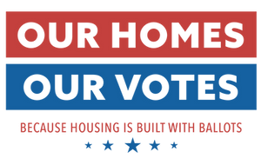
Our Homes Our Votes 2024
OHOVotes will increase state and local organizations’ capacity to conduct nonpartisan local voter engagement efforts targeting low-income renters through:
Voter registration
Voter education
Voter mobilization
Voter protection
Notes:
Phyllis
Notes:
Apart of a national initiative to see what activities get people to the polls
Only 5 pilot states
May talk about the many reasons this works- empowerment and giving people voice. Research that shows people who vote….

Slide 9
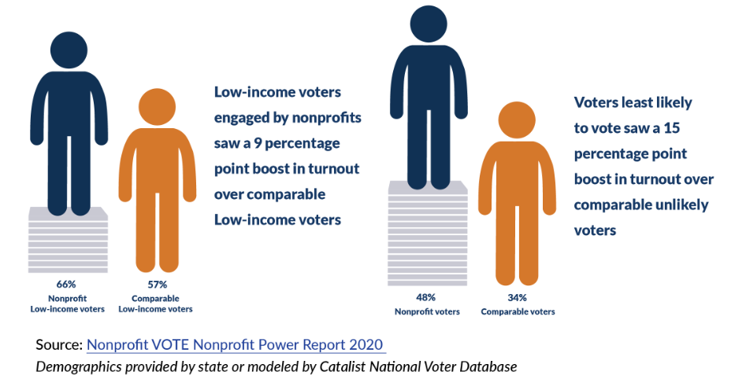
Why?
Notes:
Phyllis
When Nonprofit VOTE analyzed voter turnout from the voters engaged by the PA Votes campaign, they found that low-income voters engaged by PA Votes were more likely to turn out at the polls than other low-income voters who were not engaged by the campaign. Similarly, the PA Votes campaign also boosted turnout for voters who would otherwise have been unlikely to vote.

Slide 10
Why?
People are more likely to participate when contacted by someone they know
Voters respond best to other people, especially friends, neighbors, and community-based agencies that are familiar and trusted.
https://www.nonprofitvote.org/wp-content/uploads/2021/10/List-Seven-Tips-on-Getting-Out-the-Vote-2020.pdf
Notes:
Phyllis
Rather than focusing on impersonal handouts or mass emails, look for opportunities to initiate conversations about voting while delivering services, in meetings, on the phone, or at trainings and events.”

Slide 11
The Rules: What Can Nonprofits Do?
The IRS affirmatively states that 501(c)(3) organizations may conduct voter engagement or connect with candidates on a nonpartisan basis.
https://www.nonprofitvote.org/wp-content/uploads/2022/01/nonpartisan-election-activities-501c3-nonprofits-1.pdf
https://nlihc.org/resource/federal-housing-agencies-promote-voting-rights-and-access-hud-assisted-residents-and
Notes:
Jen
Advancing your mission

Slide 12
What Can Nonprofits Do?
You can:
Conduct or promote voter registration in your communications and client/community-facing events
Host voter registration and voter ID clinics
Remind people of registration deadlines and encourage them to vote
Educate voters on the voting process
Host a candidate forum
Distribute sample ballots or nonpartisan voter guides
Support, oppose, or host a conversation on a ballot measure
Encourage people to vote
Notes:
Lauren
We can provide resources on how to do all of these things

Slide 13
What Can’t Nonprofits Do?
You can NOT:
Endorse a candidate.
Make a campaign contribution
Rate or rank candidates on who is most favorable
Let candidates use your facilities or resources
Nonprofits may conduct any type of get out the vote activity to encourage people to vote as long as it is about participating as a voter and not suggesting who to vote for.
Notes:
LC

Slide 14
What Can Housing Authorities do?
Per a recent HUD memo, permissible activities are:
Providing household documentation of residence (e.g., address verification) to public housing residents upon request.
Permitting the use of PHA community spaces to hold meetings, candidate forums, and voter registration.
Making voter registration resources (e.g., voter registration forms) available to residents and running PHA-initiated voter registration drives.
Notes:
Jen
HUD sent an announcement only to Public Housing Authority (PHA) executive directors about activities PHAs may engage in to ensure that public housing residents and Housing Choice Voucher residents have access to voting.
Thanks to the National Low Income Housing Coalition for making the above information on HUD’s guidance to PHAs available here. (LINK: https://nlihc.org/resource/federal-housing-agencies-promote-voting-rights-and-access-hud-assisted-residents-and

Slide 15
Partnering with the Housing Alliance of PA: What Will We Do Together?
What are our goals?
YOUR SUBTITLE HERE
Support your efforts to register and mobilize voters
Provide technical support to you and other staff
Provide information on any changes in voter laws and regular communication on election dates
Provide one on one support to help you build out your organization's voter engagement plan
Provide materials, custom QR codes, and access to the online registration tool, TurboVote
Provide stipends to some organizations
Include your organization in the outcomes analysis and highlight the work you are doing

Slide 16
What Will We Do Together?
What are our goals?
YOUR SUBTITLE HERE
Provide voter registration materials and information
You could:
Include voter registration materials in any regular contact you have with residents, tenants, and people served
Are you conducting intakes for your services?
Can you set up a table in a community room?
Provide voter registration materials at a community event
Notes:
Jen

Slide 17
Strategies & Tips for Education & Engagement
Build voter registration into daily activities & already planned events
Involve your residents and clients in planning the events
Set concrete, attainable goals and tie them to deadlines
You don't have to do it all!
Partner with other local organizations and plan an event together
Add an election reminder flyer to paperwork or other items distributed to clients
Plan around civic holidays- host a National Voter Registration Day event
Send out regular communications to clients and staff
Put up a poster with election dates in a high-visibility area
Notes:
https://www.nonprofitvote.org/resource/24-ideas-to-engage-voters-in-2024/?link_id=11&can_id=95529372a1370a3fd8c47e95765f84af&source=email-529-nonprofit-vote-news-nvrd-poster-new-webinar-more&email_referrer=email_2355022&email_subject=613-nonprofit-vote-news-new-blog-webinar-alert-and-more

Slide 18
Talking to Voters
Some ways of contacting voters:
Door to door canvassing,
Phone calls, texts, emails, flyers, letters, and postcards
During intakes, lease renews, building meetings, and other one on one meetings
During community events, like parades, fairs, and sporting events
When talking to voters:
Be respectful and patient
Connect on a personal level
Know your key messages​
Make your ask
Follow- up
HAVE FUN!

Slide 19
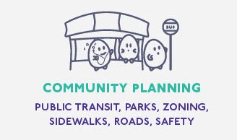
Notes:
Jen

Slide 20
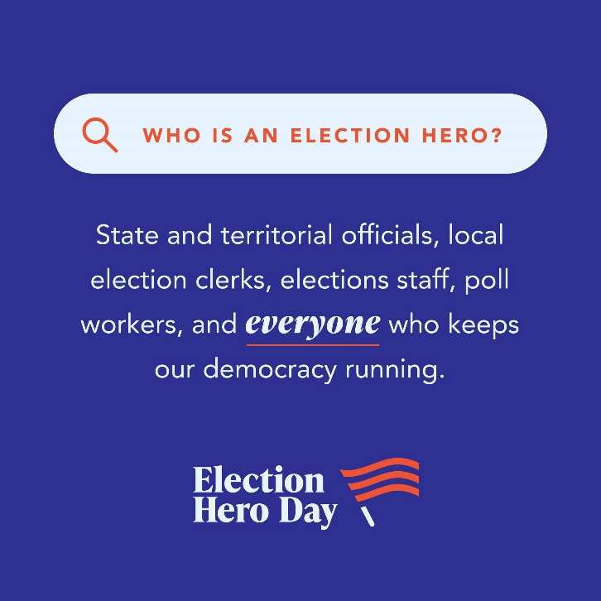
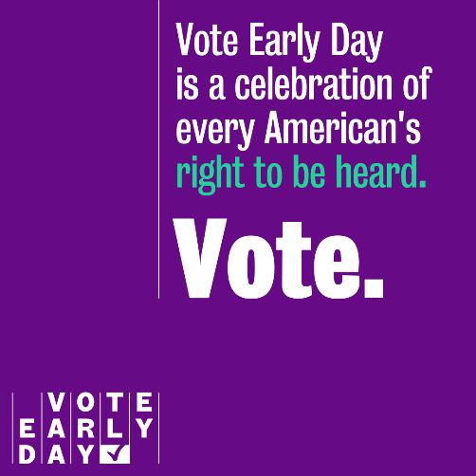
Civic Holidays
National Voter Registration Day | Tuesday, September 17, 2024
National Voter Education Week | October 7- 11, 2024
Vote Early Day | Tuesday, October 29, 2024
Election Hero Day | Monday, November 4, 2024
Notes:
Civic Holidays are nonpartisan days of action that strengthen and celebrate our country’s democracy! Each holiday accounts for a different phase of democratic participation: registering to vote, making a plan, casting a ballot, and thanking the community members who make elections possible. Together, the Civic Holidays celebrate the entire voting experience.
Discuss how each of these have their own website and endless amounts of social media and other toolkits- let me know if you want to plan around one of these and I can help you get the materials you need!
https://civicholidays.org/

Slide 21
Voter Engagement Kits
Voter Registration Forms
Key Election Date Cards
Pledge to Vote Cards
Flyers and Posters
Staff Time Off to Vote Policy Template
Email and Social Media Templates
QR Codes For Your Personalized TurboVote Link

Slide 22
Resources
Sign up for the NLIHC's free "Our Homes Our Votes Webinar Series"
Every few Mondays | 2:30 PM -3:30 PM
Explore our Voter Engagement and Education Resource Page
TurboVote
Reach out directly!

Slide 23
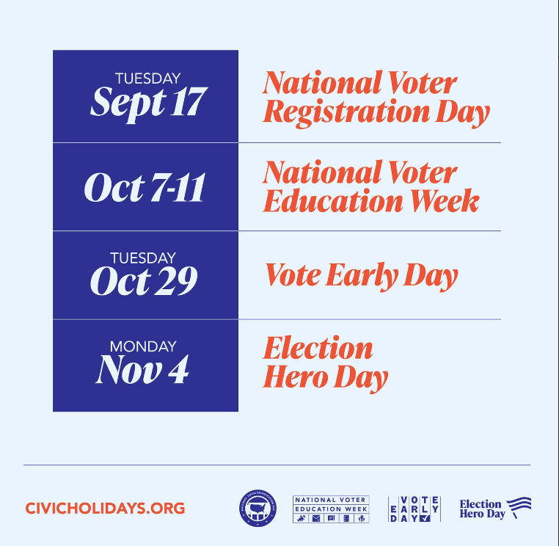
Important Election Dates
GENERAL ELECTION DAY | Tuesday, November 5, 2024
Last day to REGISTER to vote | October 21, 2024
Last day to REQUEST a mail-in or absentee ballot | October 29, 2024
Notes:
Lauren
Use this slide to talk about planning your activities around these key election dates --- LC

Slide 24
Nearly 16,000 mail ballots were rejected in PA in April
Request your ballot by: October 29, 2024 at 5 PM
Read the instruction carefully to complete your ballot
Make sure both the secrecy envelope and the outer envelope is sealed
Don't forget to sign!
Return your ballot by mail or in person!
Ballots must be received by your county election office by November 5, 2024 at 8 PM
Postmarks are not enough!

Slide 25
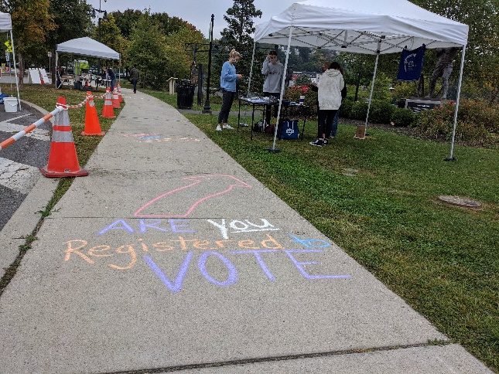
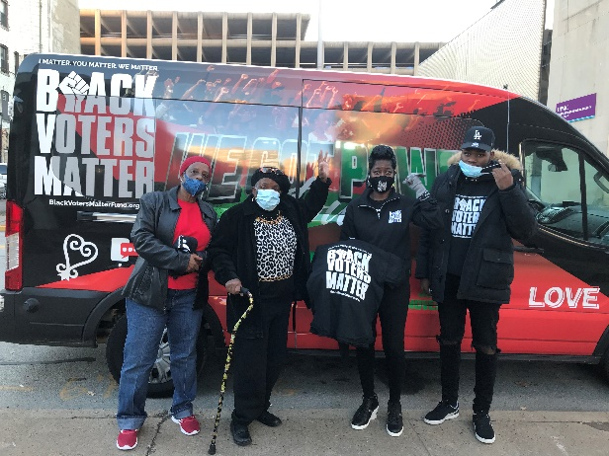
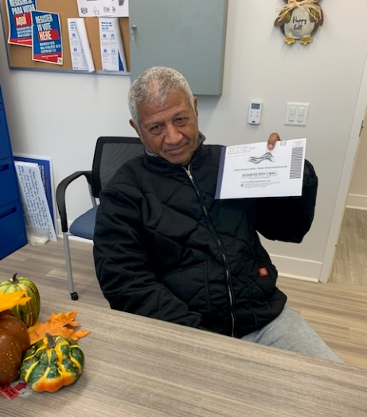
Questions?
The Pittsburgh/Rankin/Mon Valley section of the National Council of Negro Women teaming up with another organization to empower minority voters
Third Street Alliance staff engaging contacts at an outdoor event
A client of HACE is ready to vote by mail
Notes:
Pass it over to jen for q and a

Slide 26
Local Nonprofit Experience
Kim Schaffer, Community Bike Works
Notes:
Maggie/Erin introduce Kim

Slide 27
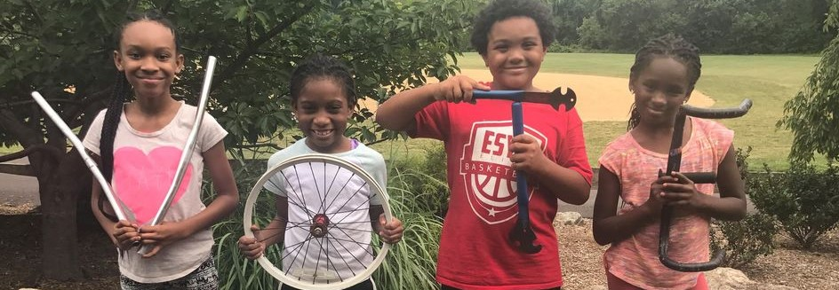
NONPROFIT ORGANIZATIONS CAN & SHOULD engage in nonpartisan voter engagement:
We are trusted messengers
We can help people overcome systemic barriers to voting
We can help elected officials understand that people care about our issues and support change

Slide 28
CBW plan covers 4 audiences:
Staff
Youth who will have turned 18 by Election Day
Families of all students in database
Visitors to pantry

Slide 29
We integrate voter engagement into programs & culture:
Staff: Offer PTO to vote/work the polls; share voting selfies
Youth: Plan Election Day programs that encourage engagement
Families of Youth: Add registration link to online registration forms
Pantry Visitors: Offer registration as part of regular intake
* Being mindful of citizenship

Slide 30
Engaging Youth (one-on-one):
Hi [NAME]- I know that being an engaged member of our community is important to you. Now that you are turning 18, you can have your voice heard in a new and meaningful way. Can we register you to vote together?
• If need to register: Can we set up a time for you come in to register? It's important for your voice to be heard, and we can help you through this brief process. (Alternately, ask if they can register with you over the phone.)
• Once registered: Great! Now let’s make a plan to vote. Are you voting by mail, or will you go to the polls? What time of day will you go? (Once you develop a plan, write it down, text to them, and follow up as a reminder.)

Slide 31
Engaging Families (group texts through Textedly):
[organization] urges you to join us in being a voter! Need to register? Sign up in 4 minutes at [LINK]. Already registered? Make a vote plan at https://vote.pa/plan. Call [NAME] at [#] with questions.
¡[organización] lo insta a unirse a nosotros para ser votante! ¿Necesitas registrarte? Regístrate en 4 minutos en [link]. ¿Ya estás registrado? Haga un plan de votación en https://vote.pa/es/plan/. Llame a [name] al [#] si tiene preguntas.

Slide 32
Engaging Pantry Visitors:
Client sign-in sheet: Include check boxes: Are you registered to vote? Can we help you register?
Flyers: Hang with QR codes linked to voter registration and find my polling places
Laptop: Provide a space where they can use our laptop to register to vote
Personal conversations: Engage them on why voting is important and help them create their vote plan
“Neighborhoods and communities that vote get more attention from candidates and officeholders.”
“Your voice matters, especially during the local elections; we can help determine what is best for our community since we live here.”
“We as a pantry only exist because of public funding and public support-- USDA food is paid for by government grants.”

Slide 33
Setting Goals & Tracking Data:
315 precincts in Lehigh & Northampton counties
2 votes per precinct = 630 new & activated voters
Date | Type of Message | Message | # Contacted | # Registered | # Voted

Slide 34
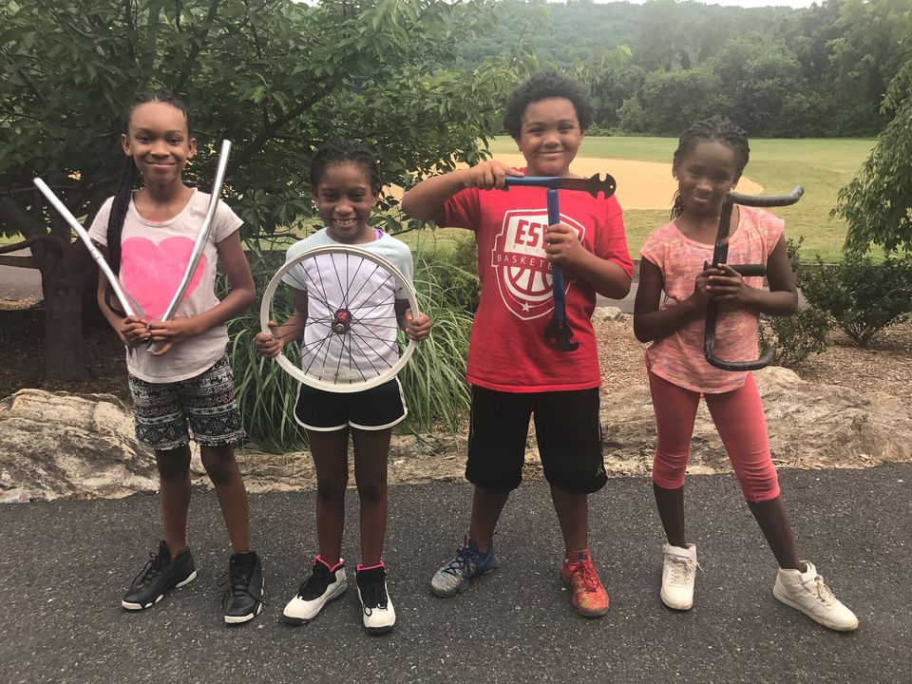
LET’S DO THIS!

Slide 35
Additional Examples
Jen Thomas, Housing Alliance of PA
Notes:
Jen

Slide 36
On the Ground Example
Jan Bechtel (They/Them)
Resident Services Program Manager, HDC Mid-Atlantic
Notes:
Lauren will pass it over to Jennifer -- they’ve been a partner for the last two cycles

Slide 37
On the Ground Example
Ashley Kimball
Service Coordinator, Parkview Towers
Notes:
Lauren will pass it over to Jennifer -- they’ve been a partner for the last two cycles

Slide 38
Q&A
Notes:
Maggie
Push back from donors or other stakeholders
How to combat mistrust in the process – “my vote doesn’t count”, etc.
Capacity – other ways to engage without staff capacity

Slide 39
Thank You
Notes:
Maggie
Additional resources
Next steps
Thank you – webinar is recorded

